Slide 1
Data Structures and Algorithms -3 (25CS2103E)
Title of the project
Team Members
Name: 2520030271 – Raghava Akkinepally
2520030060-JANUMPALLY HANSIKA
2520030212-N.RISHIKA CHOWDARY
Under the Esteemed Guidance of
Dr S. Madhavi Mam CSE department

Slide 2
Contents
Abstract
Introduction
Literature survey
Problem Statement and Objectives
Hardware and Software requirements
Results
Conclusion
Future Scope

Slide 3
Abstract
PaperCheck is a plagiarism detection system designed to identify similarities between an uploaded research paper and a dataset of reference research papers. The system extracts text from the uploaded PDF, preprocesses the content, and divides it into K-grams. Rolling Hash is used to generate hash values for these text sequences, while the Rabin-Karp algorithm efficiently compares the hash values to identify matching content. The system calculates the similarity percentage and provides a ranked list of matching reference papers. This project demonstrates the practical application of Data Structures and Algorithms to solve the problem of efficient plagiarism detection.

Slide 4
Introduction
Plagiarism is the use of existing content without proper originality or acknowledgment.
Manually checking large research papers is time-consuming.
PaperCheck provides an automated approach to identify similar content.
The user uploads a research paper in PDF format.
The system extracts and preprocesses the text.
Rolling Hash generates hash values for text sequences.
Rabin-Karp is used to efficiently identify matching sequences.
The final result shows the similarity between the uploaded paper and reference papers.

Slide 5
Literature Survey
Existing Approach | Limitation
Manual plagiarism checking | Time-consuming
Keyword-based matching | May miss similar sentences
Direct text comparison | Expensive for large documents
Traditional string matching | Repeated comparisons can be inefficient
Hash-based matching | Faster comparison using hash values

Slide 6
Problem Statement and Objectives
Problem Statement
To develop a plagiarism detection system that efficiently compares an uploaded research paper with a collection of reference papers using Rolling Hash and Rabin-Karp algorithms.
Objectives
Accept research papers in PDF format.
Extract text from uploaded papers.
Preprocess the extracted text.
Divide text into K-grams.
Generate hash values using Rolling Hash.
Detect matching sequences using Rabin-Karp.
Calculate similarity percentage.
Display matching reference papers and ranked results.

Slide 7
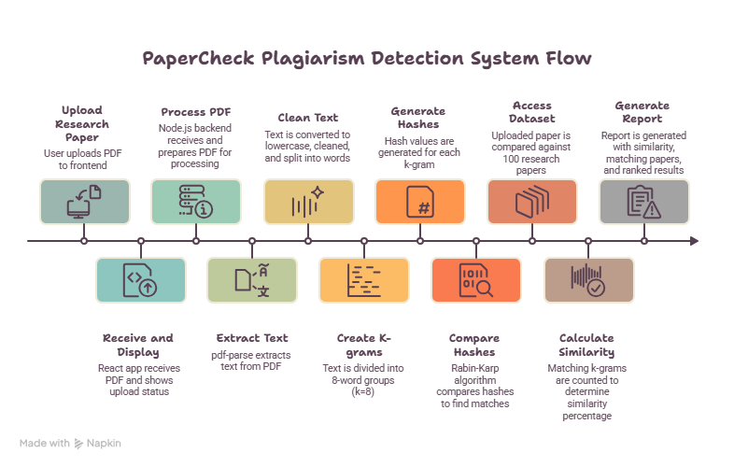
Flow Chart

Slide 8
Results
Expected Results
The system displays:
Uploaded paper name
Number of words extracted
Number of reference papers analyzed
Matching reference papers
Number of matching K-grams
Similarity percentage
Ranked list of similar papers
Example:
Uploaded Paper: ResearchPaper.pdf
Reference Papers: 100
K-Gram Size: 8
Algorithm: Rolling Hash + Rabin-Karp
Similarity: 32.45%

Slide 9
Hardware and Software requirements
Hardware Requirements
Computer/Laptop
Minimum 4 GB RAM
Minimum 10 GB available storage
Internet connection for development/deployment
Software Requirements
Operating System: Windows/Linux
Frontend: React.js + Vite
Backend: Node.js + Express.js
Language: JavaScript
PDF Processing: pdf-parse
File Upload: Multer
Algorithms: Rolling Hash + Rabin-Karp
Dataset: Research Paper PDFs
Editor: Visual Studio Code

Slide 10
Conclusion
PaperCheck provides an automated approach for plagiarism detection.
The system processes research papers and compares their textual content.
Rolling Hash efficiently generates hash values for K-grams.
Rabin-Karp identifies matching sequences using these hash values.
The system generates similarity percentages and ranked matching papers.
The project demonstrates how DSA concepts can be applied to a real-world problem.

Slide 11
Future Scope
Increase the dataset from 100 papers to thousands of papers.
Add support for DOC/DOCX files.
Add OCR for scanned research papers.
Highlight the exact matching passages.
Generate downloadable plagiarism reports.
Add multiple similarity detection techniques.
Improve processing speed for large datasets.
Add a web-based cloud deployment.

Slide 12
Thank you

